Slide 1
Peptic ulcer disease
By
Sara Mohammad Mahrous
Assistant Lecturer Of Tropical Medicine And Gastroenterology

Slide 2
Case no 1:
A 73-year-old man presents to the emergency department with A 5-day history of black tarry stool and abdominal pain .
Just before admission he felt sick and vomited dark blood .
There is a history of previous orthopedic condition from around 3 months and the patient is on analgesics ever since.
On examination:
Pallor.
No organomegaly.
Abdominal US>> normal

Slide 3
Diagnosis:
Non variceal bleeding (mostly peptic ulcer).
Management :
Resuscitation.
Proton pump inhibitors.
Endoscopy.
Determine the etiology of ulcer
Discontinue NSAID use if possible
Eradicate H. pylori infection if present or strongly suspected, even if other risk factors (e.g., NSAID use) are also present.

Slide 4
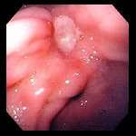
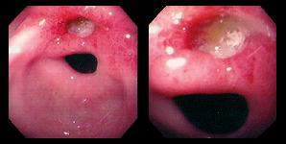
Gastric Ulcer on Endoscopy
Chronic Gastric Ulcers

Slide 5
Case no 2:
A36 year old man presents to the clinic for epigastric pain and vomiting of 6 months duration
Patient is heavy smoker
Patient improve on antacids temporarily
On examination patient is vitally stable with unremarkable abnormality
Upper endoscopy was done show gastric ulcer

Slide 6
Diagnosis:
Gastric ulcer.
Management :
Determine the etiology of ulcer e.g discontinue smoking
Eradicate H. pylori infection if present or strongly suspected, even if other risk factors (e.g., NSAID use) are also present.
Use PPI.

Slide 7
Case no 3:
A case of 30-year-old female patient presents to the emergency department with a history of passage of black tarry offensive stool from 3 days and vomiting of large amount of blood before admission.
She also complains of sever upper abdominal pain .
She is a heavy smoker and on several over the counter medications
On history :there is a past similar condition from 3 years and the patient turned to have a peptic ulcer
On examination her vitals were unstable.

Slide 8
Diagnosis:
Non variceal bleeding (mostly peptic ulcer)
Management :
Resuscitation.
Proton pump inhibitors.
Endoscopy.
Consider complicated peptic ulcer so surgical consult is important.

Slide 9


